Slide 1

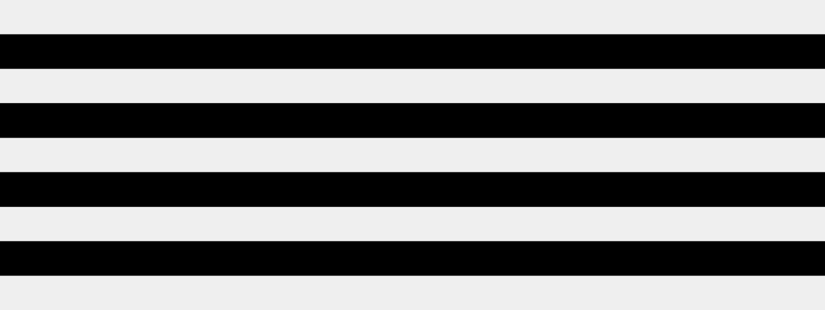
SPECİALTY:Information technology
GROUP:6224e
SUBJECT: Structure and algorithms of the variables
TEACHER’S NAME:Guluzada Dilara
STUDENT’S NAME:Alyarli Vugar

Slide 2
Presentation
Graph-Based Social Network – Use Graph Data Structure to model friendships and connections.

Slide 3
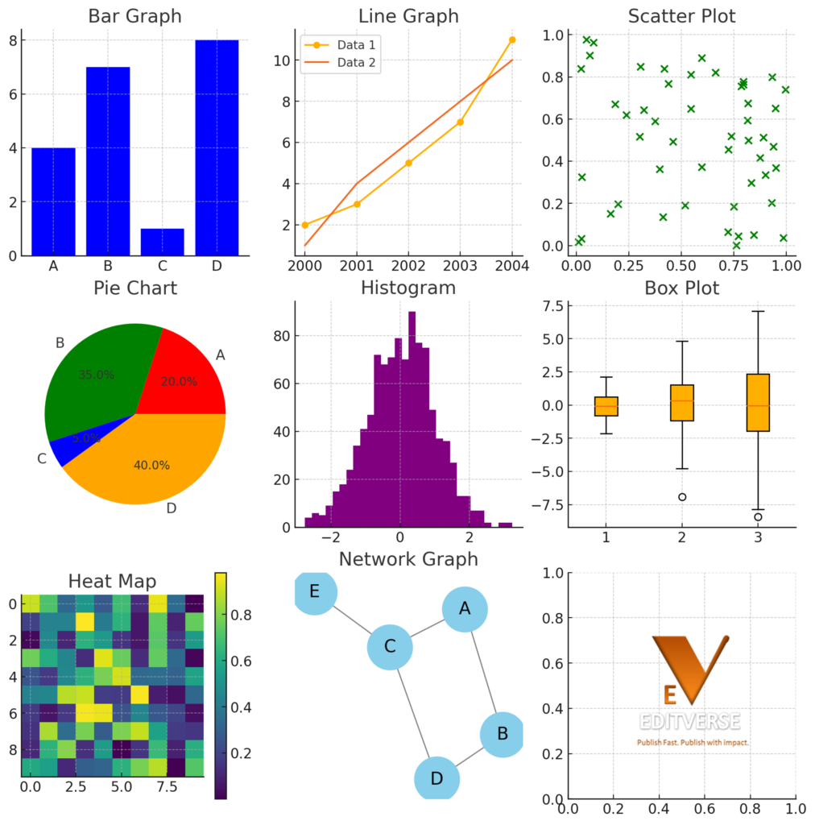
What is a Graph?
A graph is a data structure made up of nodes (also called vertices) and edges that connect pairs of nodes. In social networks, nodes represent people and edges represent relationships or interactions between them. Graphs can be undirected (mutual connections) or directed (one-way connections).
Python
import networkx as nx
G = nx.Graph() # Undirected graph

Slide 4
Adding Nodes and Edges
In a graph, nodes represent people and edges represent friendships or connections between them. You can add nodes individually or in groups, and create edges to define how they are connected. This allows us to build the structure of a social network step by step.
Python
G.add_node("Alice")
G.add_nodes_from(["Bob", "Charlie"])
G.add_edge("Alice", "Bob")
G.add_edges_from([("Bob", "Charlie"), ("Alice", "Charlie")])

Slide 5
Visualizing the Graph
Graph visualization helps us see how people are connected in a network. Using libraries like Matplotlib and NetworkX in Python, we can draw nodes and edges clearly. This makes it easier to understand relationships and patterns in the social network.
Python
import matplotlib.pyplot as plt
nx.draw(G, with_labels=True, node_color='skyblue', node_size=2000)
plt.show()

Slide 6
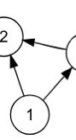
Directed Graphs (Follower Model)
A directed graph uses arrows to show one-way relationships between users. It’s perfect for modeling follower-based social networks like Twitter or Instagram. In this model, if Alice follows Bob, there’s an arrow from Alice → Bob, but not necessarily the other way.
Python
DG = nx.DiGraph()
DG.add_edges_from([("Alice", "Bob"), ("Bob", "Charlie")])
nx.draw(DG, with_labels=True, arrows=True)
plt.show()

Slide 7
Weighted Graphs (Interaction Strength)
A weighted graph includes numbers (weights) on the edges to represent the strength or frequency of interactions between users. For example, a higher weight might mean more messages exchanged or stronger friendship. This helps measure how close or active relationships are in a social network.
Python
WG = nx.Graph()
WG.add_edge("Alice", "Bob", weight=5)
WG.add_edge("Alice", "Charlie", weight=2)

Slide 8

Adjacency List and Matrix
Graphs can be represented in different ways depending on the use case.
The two most common methods are:
Adjacency List
– Stores neighbors of each node.
Adjacency Matrix
– A 2D grid showing connections between nodes.
Python
import networkx as nx
G = nx.Graph()
G.add_edges_from([("Alice", "Bob"), ("Alice", "Charlie"), ("Bob", "David")])
# Adjacency List
for node in G.adjacency():
print(f"{node[0]}: {list(node[1])}")
# Adjacency Matrix
import numpy as np
matrix = nx.adjacency_matrix(G).todense()
print(matrix)

Slide 9

Mutual Friends
Mutual friends are people who are connected to both users in the network.
We can find them by comparing the neighbors (connections) of two nodes.
Python
friends_of_alice = set(G.neighbors("Alice"))
friends_of_bob = set(G.neighbors("Bob"))
mutual = friends_of_alice & friends_of_bob
print("Mutual friends:", mutual)

Slide 10
Shortest Path Between People
The shortest path shows the minimum number of connections needed to link two users.
This helps find how closely two people are related in a social network.
Python
import networkx as nx
G = nx.Graph()
G.add_edges_from([
("Alice", "Bob"),
("Bob", "Charlie"),
("Charlie", "David"),
("David", "Eve")
])
# Find shortest path between Alice and Eve
path = nx.shortest_path(G, source="Alice", target="Eve")
print("Shortest path:", path)

Slide 11
Centrality Measures
Centrality metrics help identify the most important or influential users in a social network.
One common measure is Degree Centrality, which counts how many connections a user has.

Slide 12
Thanks!

